Slide 1
Integrating Web Tools Into the Classroom
By: Lisa Lueth, Ashlynn Montgomery, &Megan Marcy

Slide 2
What are web tools?
Technology changes everyday, and there is no way of stopping it. It is everywhere we look, our homes, car and sometimes inside our own bodies. However the largest area that you can find technology is within the school system.
Web tools have been developed to utilize technology in order to help further people’s education.

Slide 3
Web Tools Continued…
At a very young age children are exposed to technology. Having these Web Tools available for teachers to use within the classroom help not only help the students but also the teacher’s.

Slide 4
Teachers Benefits For Web Tools
Web tools such as interactive games, quizzes, slideshows, etc. helps the teacher provide a fun, new way of learning.
Web tools can help a teacher reach students who may not speak up in class.
Teachers can utilize all the many different learning styles
Many studies show an increase in standardized test scores with schools that utilize web tools.

Slide 5
Students Benefits For Web Tools
The get to learn in many different ways.
Students have an easier time staying engaged in the lessons
Students learn beneficial technology skills that will help them further in life.

Slide 6
Web Tools for the Classroom
The following Slides are examples of different web tools that can be used in the classroom.
Web poster Wizard
Ted Ed Videos
Jing Screen Capture
How to use the Flipped Classroom Model

Slide 7
Web Poster Wizard Video
http://screencast.com/t/Z1qSP2Kx
Web Poster Wizard is a free web tool that allows educators to create a lesson, worksheet, or class page and immediately publish it online. Teachers can also set up classes and assign projects to students.

Slide 8
Ted Ed Video
http://screencast.com/t/z1BoOj5m3
Ted Ed lessons are a free web tool that allows teachers to create TED-Ed lessons, and involves adding questions, discussion topics and other supplementary materials to any educational video on YouTube. Teachers can also use original TED videos and add questions and discussion topics to them as well.

Slide 9
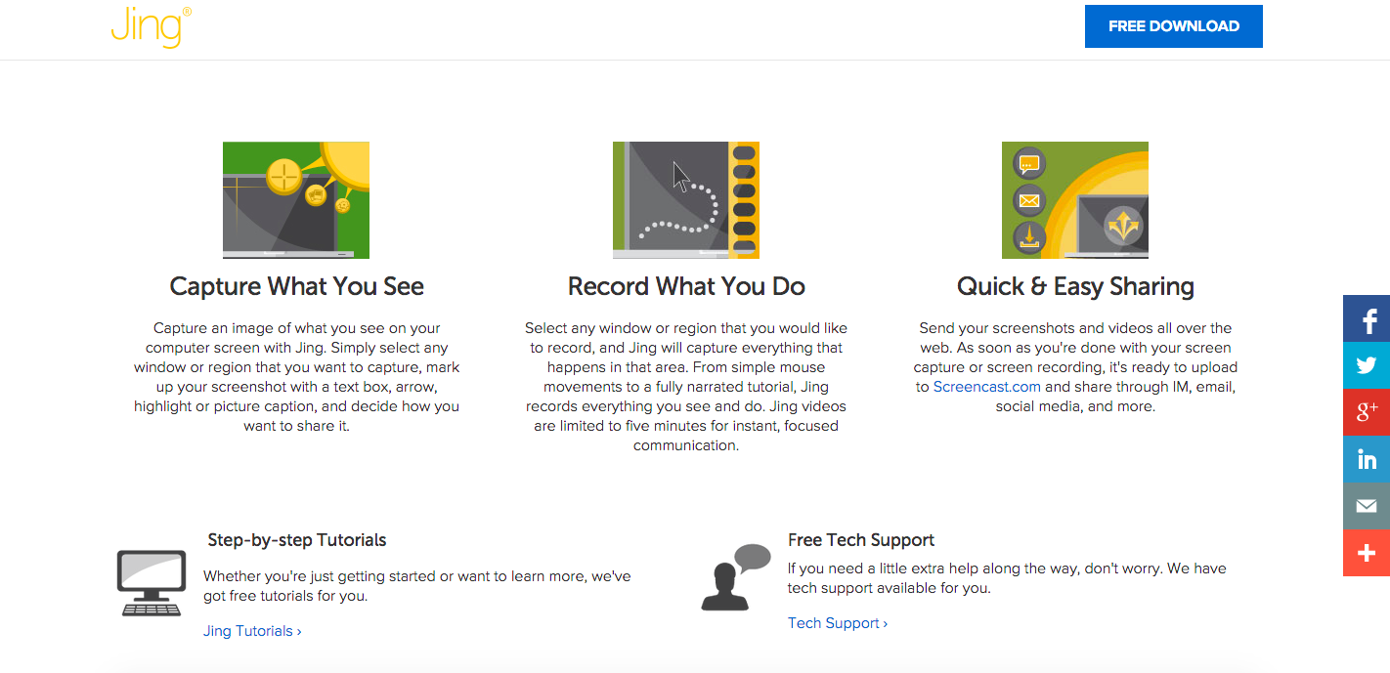
Jing Screen Capture
Jing is a free downloadable web tool that teachers can use for making video lectures to share with students or if they use the flipped classroom model then it will be used to deliver all the lessons.

Slide 11
The Flipped Classroom Model Video
http://screencast.com/t/fJIhe3Jq0mO
The flipped classroom is a pedagogical model in which the typical lecture and homework elements of a course are reversed. Short video lectures are viewed by students at home before the class session, while in-class time is devoted to exercises, projects, or discussions.
.

Slide 12
Flipped Classroom Model
With the flipped Classroom model as a web tool teachers are not just incorporating technology into their classroom, technology is the classroom by utilizing a variety of web tools to help further educate the students.

Slide 13
Why We Chose This Topic
Ashlynn’s Reason’s for this Topic

Slide 14
Reference Page
https://www.techsmith.com/jing-features.html
http://oedb.org/ilibrarian/101-web-20-teaching-tools/
http://ed.ted.com/about
https://www.sde.idaho.gov/site/tech_services/grants_contracts_docs/202_C_Hull.pdf
https://www.naeyc.org/files/yc/file/200311/TechInPrimaryClassrooms.pdf
http://poster.4teachers.org/
http://flippedlearning.org/domain/46
https://www.techsmith.com/jing.html

